Slide 1
Integrated Research Project
background

Slide 2
History
MSc in Biology is too theoretical
    “the name of the course practical taxonomy could better be replaced by theoretical reflections on practical taxonomy” – criticism by a student 2013
courses could be better integrated
    suggestion by evaluation commission

Slide 3
Integration
patterns in
space
time
evol.morph.
paleon-
tology
taxonomy
phylogeny
biogeo-
graphy
micro-
evolution

Slide 4

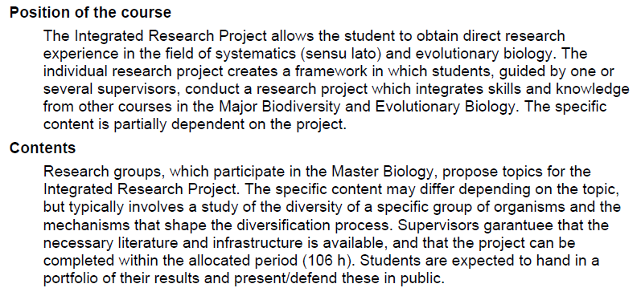
Integration

Slide 5
(past) example
Title: | Species delimitation in Lactifluus volemus sensu lato from
Supervisor | Mieke Verbeken & Kobeke Van de Putte
Research group: | Mycology
Description | Lactifluus volemus is a traditional morphological species. It was first described from in 1838, but since then, the name has been applied for morphological look-a-likes throughout the northern hemisphere. Recently, molecular data revealed that we are not dealing with a single species, but a species-complex comprising at least 40 species. While many species are cryptic, 12 species could be distinguished based on morphology so far. Species diversity seems especially high in Asia, and preliminary molecular results indicate the existence of at least 10 species in . This project aims to delimit robust species boundaries within L. volemus from by providing evidence from independent data , and two molecular analytical approaches .
Practical info | The student will use existing sequence data to reconstruct and compare single-gene phylogenetic trees in order to delimit species boundaries, reassess these species boundaries with Bayesian species delimitation, and perform a microscopic study of the revealed phylogenetic species.
Keywords | phylogeny, evolutionary morphology, cryptic species, species delimitation, fishy milkcaps

Slide 6
(past) example
Title: | Three-dimensional quantification of mouth-cavity shape in a mouthbrooding fish
Supervisor | Sam Van Wassenbergh
Research group: | Evolutionary Morphology of Vertebrates
Description | Many fish species evolved a breeding strategy in which either the male or female takes the fertilized eggs into their mouth cavity to improve physical protection and oxygen supply. Yet, little is known about the ventilation motions performed by the head of the mouthbrooding parent generate a suitable flow of water to cause optimal oxygen uptake conditions for the batch of eggs. We recently discovered that this ventilation involves both anterior-to-posterior flows of water (as in normal gill ventilation) and posterior-to-anterior flows (so-called churning). However, to better understand why this combination of ventilation behaviors is observed, we first need to quantify the shape of the mouth cavity in our model species, the Nile tilapia (Cichlidae).
Practical info | The student will make 3D laser scans of the mouth cavity from Nile tilapia preparations including casts of silicones injected intra-orally, and reconstruct the mouth-cavity surfaces using professional mesh editing software (Geomagic). Different scans in which typical “head posture” during mouthbrooding (i.e. depressed hyoid, abducted suspensoria) is imposed on the specimens, will allow the student to measure the resultant volume increase, and the effect thereof on mouth cavity shape.
Keywords | morphology, cichlids, mouthbrooding, ventilation

Slide 7


Anno 2018
… an idea, an interest
… an expertise
… a lab
initiative
communicate
agree

Slide 8
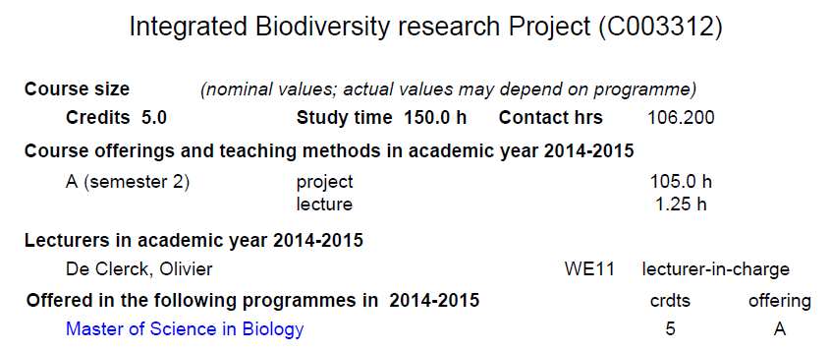
... and in practice

Slide 9
... and in practice
how much is 106 h ?
  quite a bit
    1.5 days/week for 10 weeks
    5 day/week for 3 weeks
    or variations of the above
up to you and your supervisor to make a plan
supervisors report to me (time-sheet)

Slide 10
Designing a topic
20.11.19: introduction
10.02.20: present topics and workplan
[in case of problems talk to me]
Slide1
intro
Slide2
Research Q
Slide3
workplan

Slide 11
start your project
negotiate time-schedule with supervisor
inform me (email) regarding the time-schedule
start your work

Slide 12
present your project
when? to be communicated
how? presentation (e.g. ppt) + portfolio
what is a portfolio?
  a zip-file of all documents essential for your project, submitted to dropbox.
  e.g. raw morphometric data, DNA sequences, counts, result of analysis.

Slide 13
... and off you go !
Did the subjects offered appeal to you?
Yes: 86% // No: 14%
Do you agree with the allocation of the research proposal on a first come first serve basis?
Yes: 50%
No: 50%
Is the number of research projects offered sufficient? This year we offered 14 subjects in 7 research groups for 11 students.
Yes: 75%
No: 25%
The current structure of the course, where each student can decide individually on his/her time management, is ok?
Yes: 100%
No: 0%
There was enough time available in the second semester to work on the project?
Yes: 67%
No: 33%
Would you consider the opportunity to conduct the research project in an external research institure (e.g. Botanical Garden, ...)
Yes: 67%
No: 33%
You were happy with the supervision, the time supervisors devoted to your project and their scientific input ?
Yes: 100%
No: 0%
You would prefer to submit a real report rather than the current portfolio?
Yes: 17%
No: 83%

